Slide 1
Jupyter Notebook
Bio-Data Club Session
2020-03-27
Miguel E. Betin

Slide 2
Jupyter Notebook
The Jupyter Notebook enables users to create and share documents that combine live code with narrative text, mathematical equations, visualizations, interactive controls, and other rich output.
"Jupyter" is a loose acronym meaning Julia, Python, and R. These programming languages were the first target languages of the Jupyter application, but nowadays, the notebook technology also supports many other languages.
The Jupyter Notebook supports the latest versions of these browsers:
Chrome
Safari
Firefox

Slide 3
Components
The notebook web application: An interactive web application for writing and running code interactively and authoring notebook documents.
Kernels: Separate processes started by the notebook web application that runs users’ code in a given language and returns output back to the notebook web application.
Notebook documents: Self-contained documents that contain a representation of all content visible in the notebook web application, including inputs and outputs of the computations, narrative text, equations, images, and rich media representations of objects. Each notebook document has its own kernel.

Slide 4
Installation
While Jupyter runs code in many programming languages, Python is a requirement (Python 3.3 or greater, or Python 2.7) for installing the Jupyter Notebook.
Anaconda conveniently installs Python, the Jupyter Notebook, and other commonly used packages for scientific computing and data science.
Install Anaconda.
Run “jupyter notebook”.

Slide 5
Notebook Documents
Notebook documents contain the inputs and outputs of an interactive session as well as narrative text that accompanies the code. Rich output generated by running code, including HTML, images, video, and plots, is embedded in the notebook, which makes it a complete and self-contained record of a computation.
Notebooks can be exported to different static formats including HTML, reStructeredText, LaTeX, PDF, etc.

Slide 6
Notebooks consist of a linear sequence of cells. There are three basic cell types:
Code cells: Input and output of live code that is run in the kernel
Markdown cells: Narrative text with embedded LaTeX equations
Raw cells: Unformatted text that is included.

Slide 7
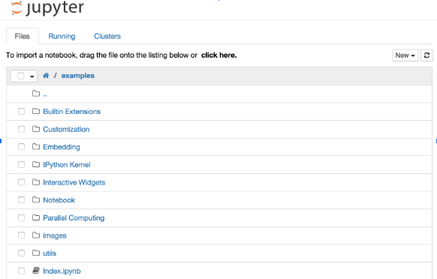
The Notebook dashboard
The dashboard serves as a home page for the notebook. Its main purpose is to display the notebooks and files in the current directory.

Slide 8
Notebooks and files can be uploaded to the current directory by dragging a notebook file onto the notebook list or by the “click here” text above the list.
The notebook list shows green “Running” text and a green notebook icon next to running notebooks (as seen below). Notebooks remain running until you explicitly shut them down; closing the notebook’s page is not sufficient.

Slide 9
Notebook UI
If you create a new notebook or open an existing one, you will be taken to the notebook user interface (UI). This UI allows you to run code and author notebook documents interactively. The notebook UI has the following main areas:
Menu.
Toolbar.
Notebook area and cells.
The notebook has an interactive tour of these elements that can be started in the “Help:User Interface Tour” menu item.

Slide 10
The keyboard does different things depending on which mode the Notebook is in. There are two modes: edit mode and command mode.
Edit mode
Edit mode is indicated by a green cell border and a prompt showing in the editor area:
When a cell is in edit mode, you can type into the cell, like a normal text editor.
Enter edit mode by pressing Enter or using the mouse to click on a cell’s editor area.

Slide 11
Command mode
Command mode is indicated by a grey cell border with a blue left margin:
When you are in command mode, you are able to edit the notebook as a whole, but not type into individual cells. Most importantly, in command mode, the keyboard is mapped to a set of shortcuts that let you perform notebook and cell actions efficiently.

Slide 12

Mouse navigation
All navigation and actions in the Notebook are available using the mouse through the menubar and toolbar, which are both above the main Notebook area:
Cells can be selected by clicking on them.
Cell actions usually apply to the currently selected cell.

Slide 13
Keyboard Navigation
The modal user interface of the Jupyter Notebook has been optimized for efficient keyboard usage. This is made possible by having two different sets of keyboard shortcuts: one set that is active in edit mode and another in command mode.
The most important keyboard shortcuts are Enter, which enters edit mode, and Esc, which enters command mode.
In edit mode, most of the keyboard is dedicated to typing into the cell’s editor. Thus, in edit mode there are relatively few shortcuts. In command mode, the entire keyboard is available for shortcuts, so there are many more. The Help->``Keyboard Shortcuts`` dialog lists the available shortcuts.

Slide 14
Basic Commands:
Basic navigation: enter, shift-enter, up/k, down/j
Saving the notebook: s
Change Cell types: y, m, 1-6
Cell creation: a, b
Cell editing: x, c, v, d, z
Kernel operations: i, 0 (press twice)

Slide 15
Run a code cell using Shift-Enter.
Alt-Enter runs the current cell and inserts a new one below.
Ctrl-Enter run the current cell and enters command mode.

Slide 16
http://jupyter/
http://jupyter.moffitt.org/
50 Accounts:
Username: user1
Password:user1

Slide 17
JupyterLab is the nex-generation user interface including notebooks. It has a modular structure, where you can open several notebooks or files as tabs in the same window. It offers much more an IDE-like experience.
https://jupyter:8000/user/your_username/lab?

Slide 18
Useful Links
https://jupyter.org/
https://github.com/jupyter/jupyter/wiki/A-gallery-of-interesting-Jupyter-Notebooks

